Slide 1

Auction House Price Analysis
Nikolai Alexander – CSCI4502
nial3328@colorado.edu

Slide 2

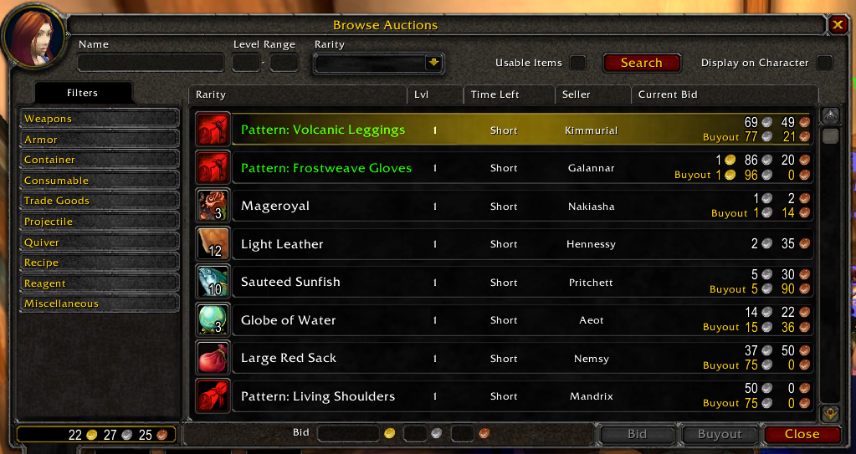
The Auction House
Faction-Wide Hub for Player-To-Player Trading
Dynamic, Highly Volatile Economy
Player Driven Competitive Pricing
Prices Affected by Demand/Popularity, Level, Relevance

Slide 3


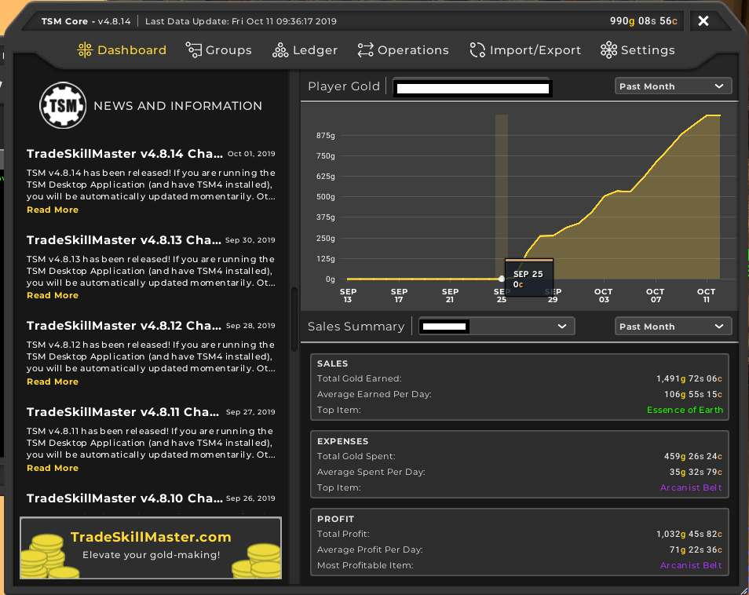
The Auction House
Players Exploit Behavior for Profit
No need for collecting items in world
Generates gold faster than any other method of income

Slide 4

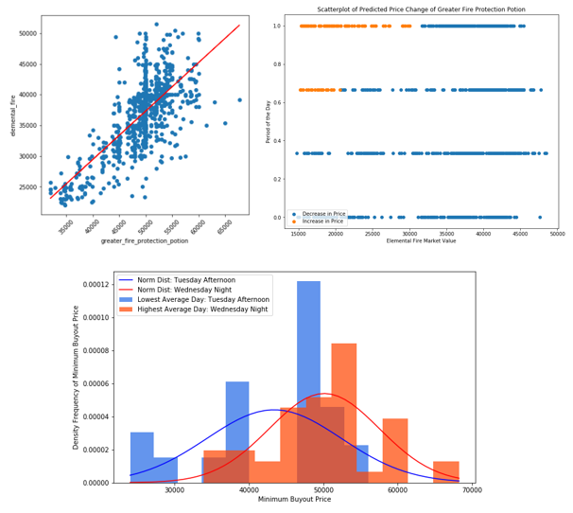
Analyzing Price Behavior
Simple Linear Regression
Correlations between Craftables & Materials
Confidence Interval Estimation
Difference in mean price between Time Intervals
K-Means Clustering
Predicting Price Change Behavior

Slide 5

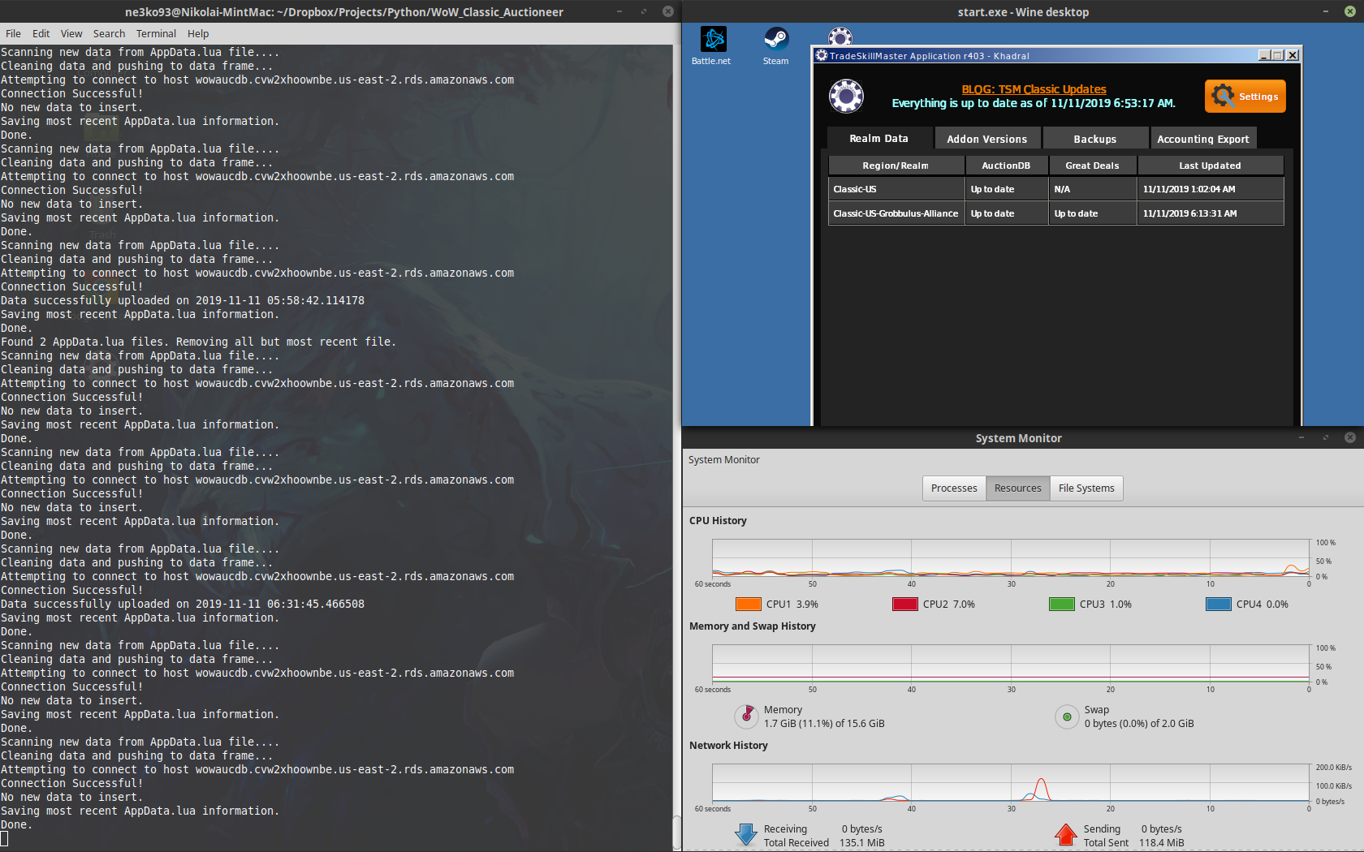
Data Collection
Script perpetually running on Linux server
Scans TradeSkillMaster data file every second – AppData.lua
If update to file, parses and preprocesses data (JSON format)
Pushes processed data to AWS server

Slide 6
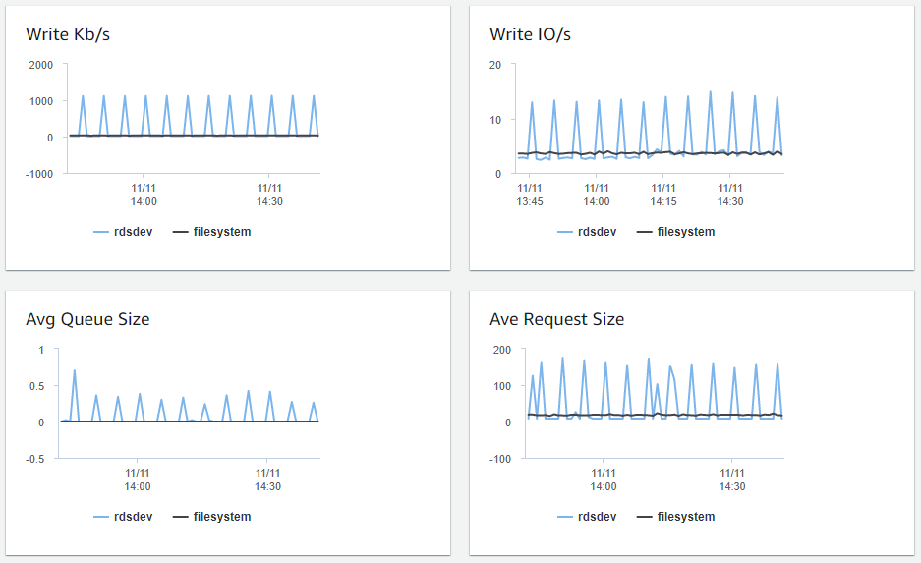
AWS Database
5966 Items
~Hourly scans dating back to October 7, 2019
Attributes: itemid, marketvalue, minbuyout, historical, numauctions, scantime
Predicted variable based off minbuyout

Slide 7


Simple Linear Regression - Algorithm
Inputs
Item ID of Craftables,
Item Name of Craftable
List of Item IDs of Materials
List of Names of Materials
Output
Summary of Linear Correlations Ordered by Pearson Correlation Coefficient
Plots of Pairwise SLR Relationships
Steps
Extract scantimes & minimum buyout prices for all items
Merge Data Sets
Produce Pearson Correlation Coefficient Matrix
pandas.dataframe.corr()
Model SLR Line for each pairwise relationship
Estimate Slope $β$ & y-intercept $α$
Calculate t-statistic
Calculate p-value
scipy.stats.t.cdf()
Calculate Coefficient of Determination $R^{2}$

Slide 8


Simple Linear Regression - Mathematics
Pearson Correlation Coefficient
$$r_{xy}= \frac{\sum_{i=1}^{n}{(x_{i}−\overline{x})(y_{i}−\overline{y})}}{\sqrt{\sum_{i=1}^{n}{{\left(x_{i}−\overline{x}\right)}^{2} }}\sqrt{\sum_{i=1}^{n}{{\left(y_{i}−\overline{y}\right)}^{2} }}}$$
Slope $β$
$$\hat{β}= \frac{\sum_{i=1}^{n}{(x_{i}−\overline{x})(y_{i}−\overline{y})}}{\sum_{i=1}^{n}{{\left(x_{i}−\overline{x}\right)}^{2} }}$$
Y-Intercept $α$
$$\hat{a}=\overline{y}−\hat{β}\overline{a}$$
T-statistic
$$t=\frac{\hat{β}}{SE(\hat{β})}$$
Standard Error
$$SE\left(\hat{β}\right)=\sqrt{\frac{1}{n−2}\frac{{\sum_{i=1}^{n}{\left(y_{i}−\hat{y}\right)}}^{2}}{\sum_{i=1}^{n}{{\left(x_{i}−\overline{x}\right)}^{2} }}}$$
P-value
$$p=\left\{\begin{aligned}1 −Φ\left(t\right) if \hat{β}≤0 \\ Φ\left(t\right) if \hat{β}>0\end{aligned}\right.$$
Coefficient of Determination
$$R^{2}=1 − \frac{SSR}{SST}$$
Residual Sum of Squares
$$SSR=\sum_{i=1 }^{n}{{\left({\hat{y}}_{i}−\overline{y}\right)}^{2}}$$
Total Sum of Squares
$$SST=\sum_{i=1 }^{n}{{\left(y_{i}−\overline{y}\right)}^{2}}$$

Slide 9
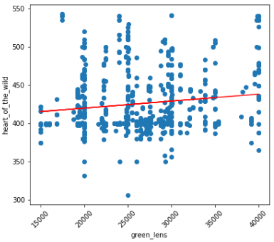

Simple Linear Regression – BiS Results
Generally Quite Poor Performance
Green Lens vs Heart of the Wild
$p=2.84e^{−5}$
$r_{xy}=0.137$
$R^{2}=0.0188$

Slide 10
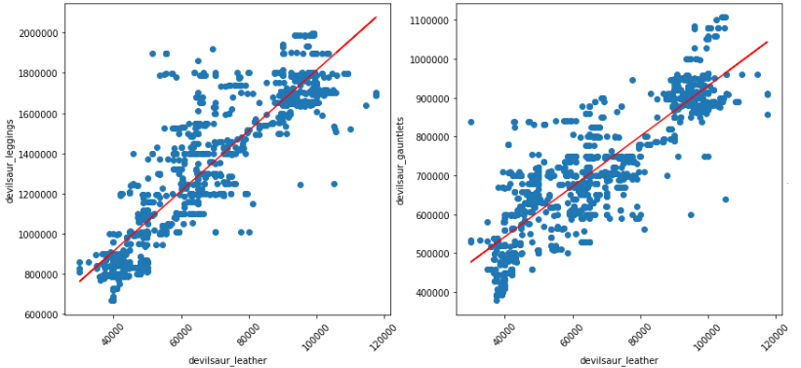

Simple Linear Regression – Devilsaur Leather
Contrary to other BiS, performed well
Devilsaur Leggings vs Devilsaur Leather
$p=0.00$
$r_{xy}=0.81$
$R^{2}=0.67$
Devilsaur Gauntlets vs Devilsaur Leather
$p=0.00$
$r_{xy}=0.828$
$R^{2}=0.68$

Slide 11
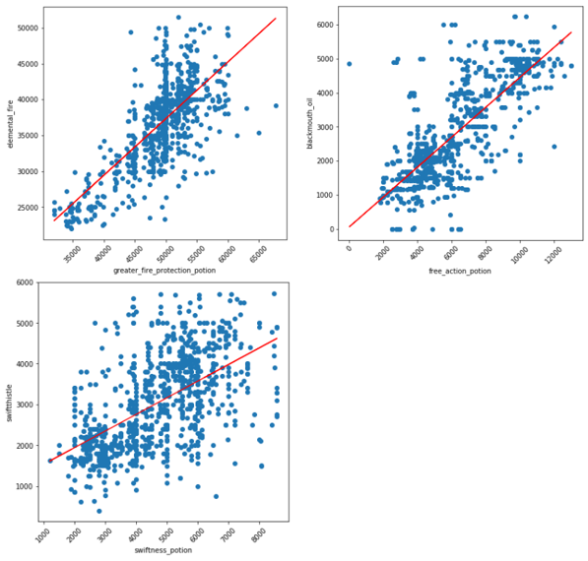

Simple Linear Regression – Consumables
Consistently performed better than BiS
Greater Fire Protection Potion vs Elemental Fire
$p=0.00, r_{xy}=0.72, R^{2}=0.52$
Free Action Potion vs Blackmouth Oil
$p=0.00, r_{xy}=0.78, R^{2}=0.608$
Swiftness Potion vs Swiftthistle
$p=0.00, r_{xy}=0.57, R^{2}=0.327$

Slide 12
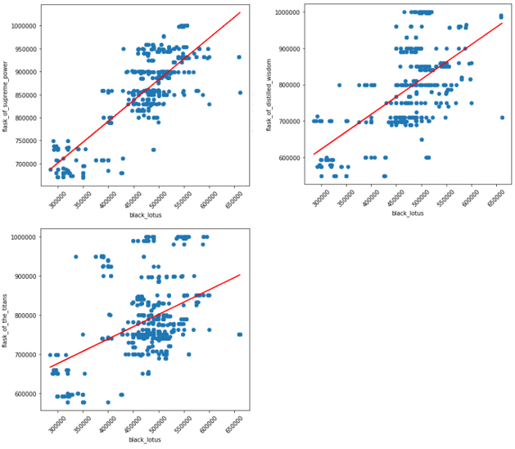

Simple Linear Regression – Flasks
All share same main ingredient – Black Lotus
Correlation proportional to player population
Flask of Supreme Power vs Black Lotus
$p=0.00, r_{xy}=0.81, R^{2}=0.657$
Flask of Distilled Wisdom vs Black Lotus
$p=0.00, r_{xy}=0.607, R^{2}=0.369$
Flask of the Titans vs Black Lotus
$p=0.00, r_{xy}=0.431, R^{2}=0.186$

Slide 13



Time-Interval Analysis – Methodology
Split minimum buyout prices into subsets based on time interval
Day of the Week, Hour of the Day, Part of the Day (Morning, Afternoon, Evening, Night)
Compare Best Performing Interval and Worst Performing Interval
Performance measured by sample mean
Significance measured by p-value within significance level $α=0.05$
T-statistic for difference in means
$$t= \frac{μ_{1}−μ_{2}}{\sqrt{{σ_{1}^{2}}/{n_{1}}}\sqrt{{σ_{2}^{2}}/{n_{2}}}}$$
Degrees of Freedom
$$df= \frac{{\left({σ_{1}^{2}}/{n_{1}}+{σ_{2}^{2}}/{n_{2}}\right)}^{2}}{{{\left({σ_{1}^{2}}/{n_{1}}\right)}^{2}}/{\left(n_{1}−1\right)}+{{\left({σ_{2}^{2}}/{n_{2}}\right)}^{2}}/{(n_{2}−1)}}$$
p-value
$$p=1 −φ(t)$$

Slide 14
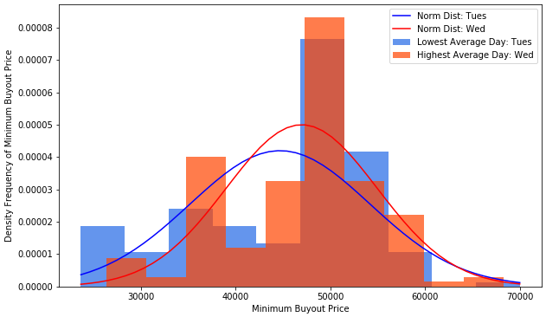

Time-Interval Analysis – Weekday Intervals
Best Performing Day – Wednesday
$μ=4g 69s 84c$, $σ=79s 81c$
Worst Performing Day – Tuesday
$μ=4g 46s 94c$, $σ=95s 06c$
P-value: $p=0.0102$

Slide 15
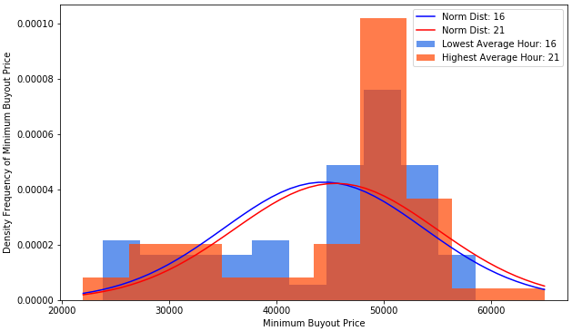

Time-Interval Analysis – Hourly Intervals
Best Performing Hour – 9pm-10pm
$μ=4g 84s 10c$, $σ=88s 36c$
Worst Performing Day – Tuesday
$μ=4g 42s 76c$, $σ=94s 46c$
P-value: $p=0.2712$

Slide 16
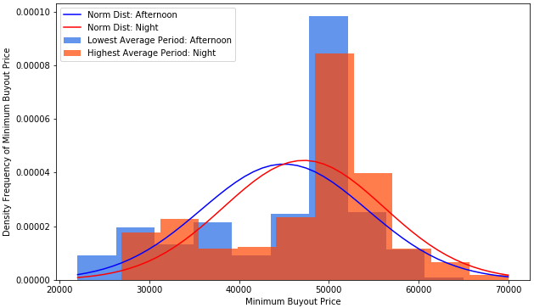

Time-Interval Analysis – Part of Day Intervals
Best Performing PoD – Night (9pm-5am)
$μ=4g 71s 98c$, $σ=89s 58c$
Worst Performing Day – Afternoon (12pm-5pm)
$μ=4g 50s 17c$, $σ=92s 44c$
P-value: $p=0.00137$

Slide 17
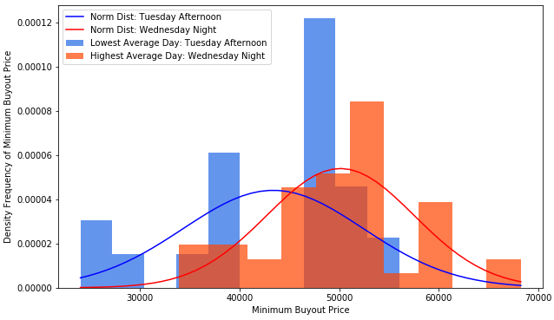

Time-Interval Analysis – Theoretical Best vs Theoretical Worst
Wednesday Night (Theoretical Best)
$μ=5g 01s 26c$, $σ=74s 02c$
Tuesday Afternoon (Theoretical Worst)
$μ=4g 33s 79c$, $σ=90s 60c$
P-value: $p=0.000164$

Slide 18

K-Means Clustering - Algorithm
Input
Matrix of Predictor Variables
Real Class Values
K value (# of classes)
Stopping Condition
Number of iterations
Convergence of Centroids
Distance Metric
Euclidean, Manhattan, Infinite, Cosine, Lr
r for Lr distance
Output
Matrix of Centroids for each Cluster
Predicted Classes
Accuracy of Prediction
Confusion Matrix

Slide 19
K-Means Clustering - Algorithm
Initialization
Centroids
First centroid picked as random point
Following centroids picked as furthest distance from previous centroids
Initial Predicted Classes – Centroid of minimum distance from point
Iteration
Assign class for each instance by minimum distance from centroids
Update centroids to be center of each new cluster
Convergence
Reach assigned number of iterations
Centroids converge to central point

Slide 20
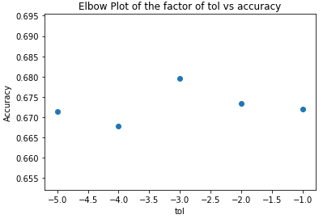

K-Means Clustering - Tuning
Best Attributes (significance level $α=0.05)$
Part of the Day
Pearson Correlation: 0.024
P-value: 0.00789
Elemental Fire Market Value
Pearson Correlation: -0.015
P-value: -0.0104
Optimal Distance Metric
Cosine Distance (68% Accuracy)
All other distances around (58% Accuracy)
Optimal Stopping Condition
Convergence of Centroids
Difference of 0.001

Slide 21
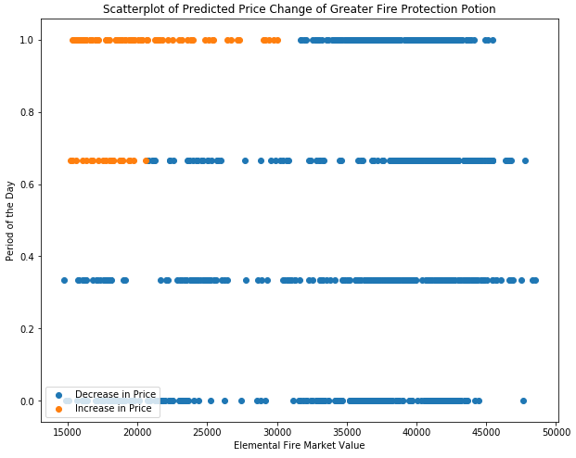
K-Means Clustering - Results
Accuracy: 70.17%
Confusion Matrix
91% Bias towards Decreasing / No Change
 | Decrease/ No Change | Increase
Decrease/ No Change | 745 | 76
Increase | 250 | 22

Slide 22
Conclusion
Predicting price trends with Confidence Interval Estimation of worst/best performing time-intervals gave the best results.
Tuesday Afternoon is the best time to buy Greater Fire Protection Potion, while Wednesday Night is the best time to sell.
Correlates with weekly server reset and raiding schedules
K-means cluster is the worst performing method of prediction for this situation
Only 70% accuracy
Too many variables and too much randomness in price to predict specific price changes

